Slide 1

Avoiding the Middle Income Trap Renovating Industrial Policy Formulation in Vietnam
Author: Kenichi Ohno (2010)
Presented by: Ahmad Waleed Majidyar
Class: Economic Development (Econ 541)

Slide 2
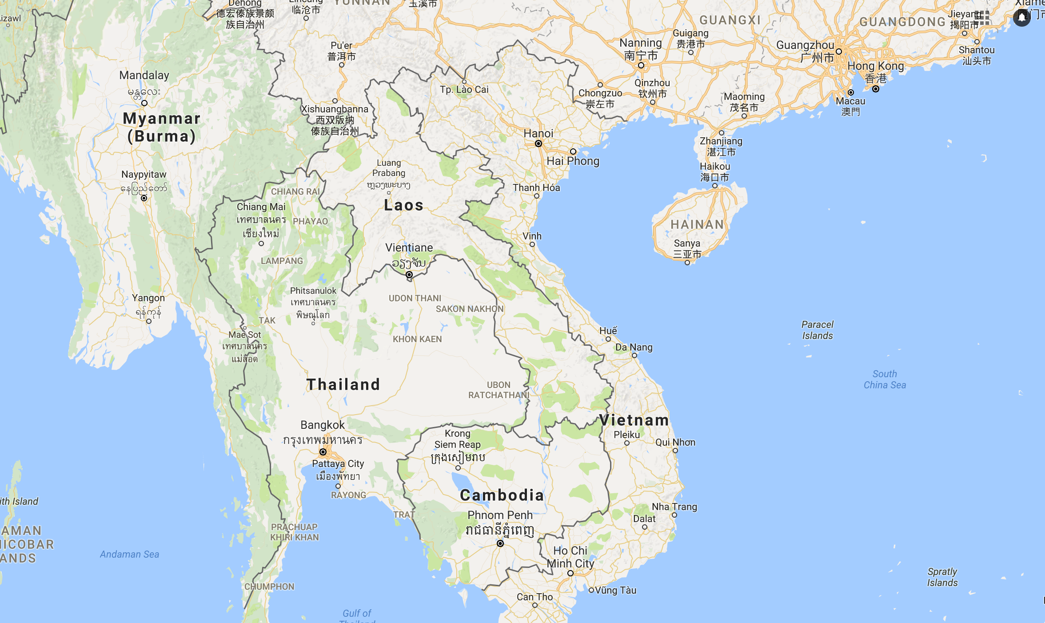
Outline
Overview
Vietnam’s Problem
Vietnam’s Performance Within East Asia
Malaysia’s and Thailand’s Experience
Policy Structure
Policy Making Challenges
Policy Proposal
Conclusion

Slide 3
About Vietnam
Indicator | Total
Population | 91.7 Million
Age Group Distribution | 23% Under 14; 70% between 15-64 Years
Gender | 50.5% Female, 49.5% Male
HDI Ranking | 116th
Total GDP | $193.6 Billion
GDP Growth rate | 6.7%
GDP Per Capita | $2,111
Unemployment Rate | 2.3%
Poverty Rate | 4.5%
Source: The World Bank

Slide 4
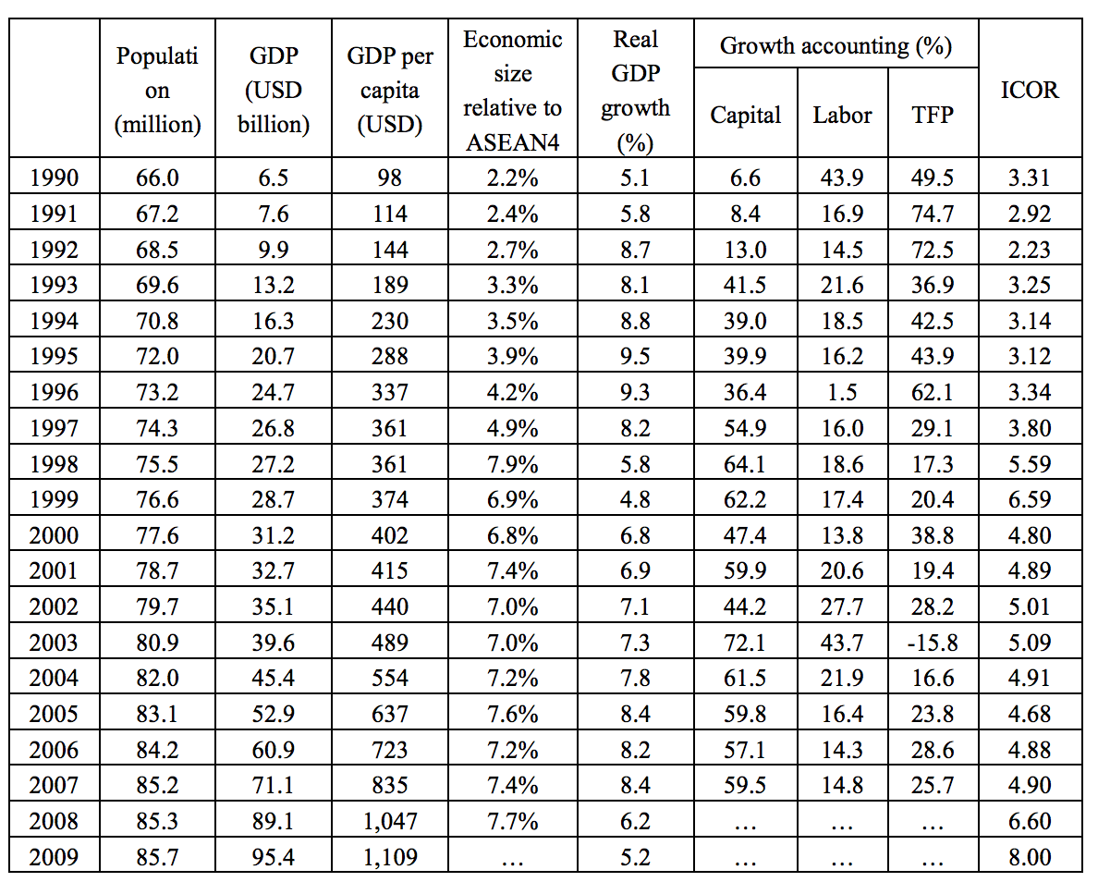
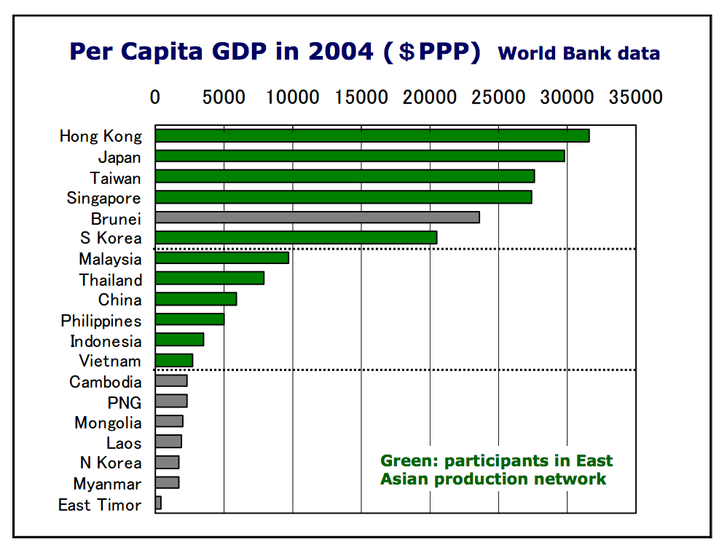
Vietnam’s Problem
Despite remarkable growth in the last on—and-half decades that has been driven by the one-time liberalization effect and large inflows of external purchasing power, Vietnam needs to create internal value to continue to grow towards higher income and avoid the middle income trap .

Slide 5
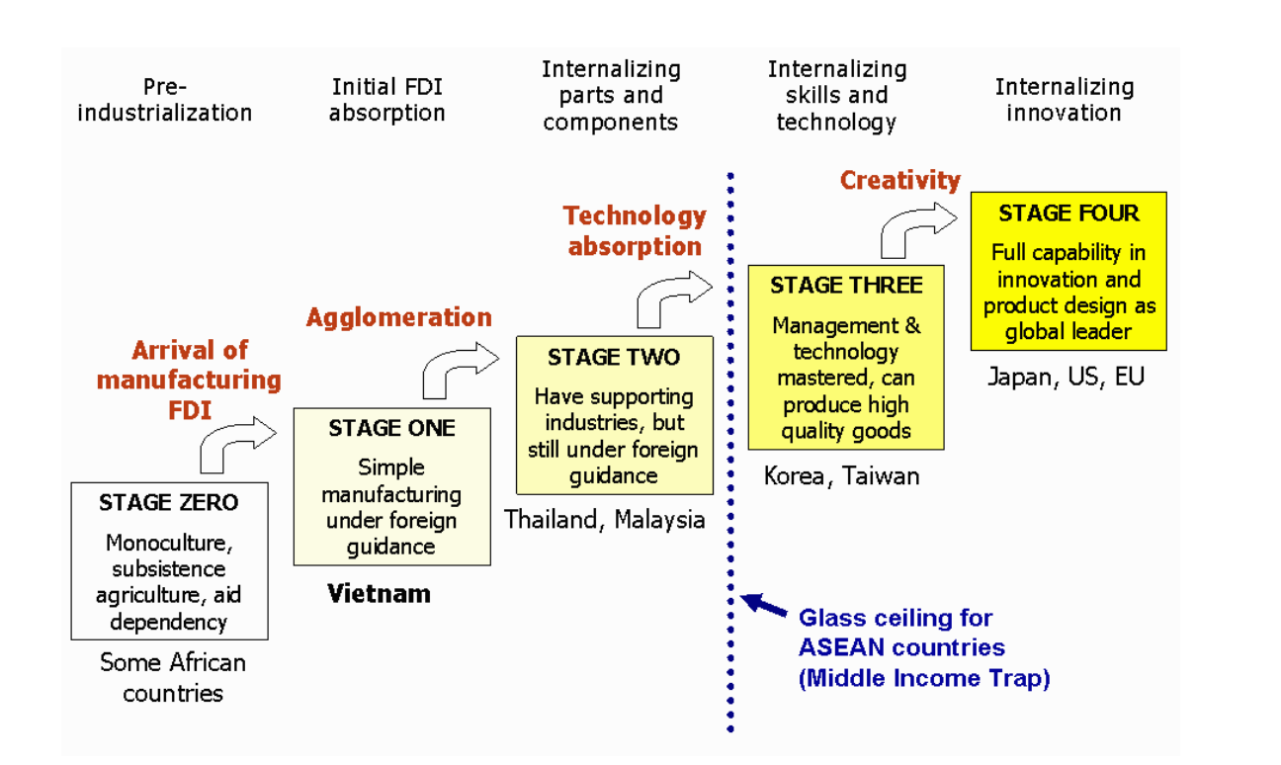
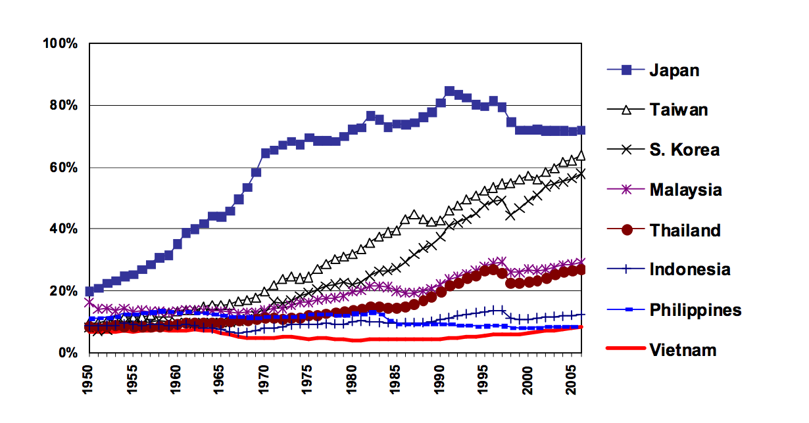
Divergent Performance Within East Asia

Slide 6
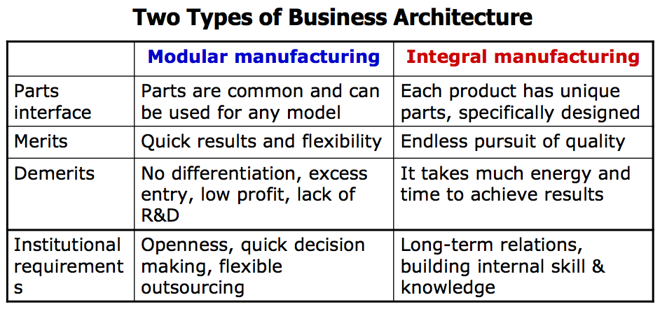
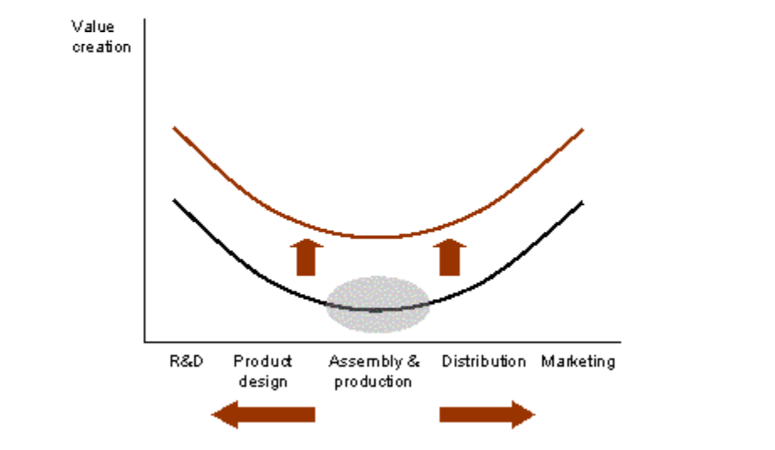
Some Related Arguments
To remain competitive: Improve Labor productivity faster than wage increase (Vietnam experience rising wages as a result of concentration over labor intensive FDI than high tech investors)
Malaysia’s Manufacturing Plus Plus
The Japanese Concept of Monozukuri (Making Things)
Manufacturing for achieving client satisfaction through high quality
Internal accumulation of skill and knowledge are institutionalized within each company and among partner companies.
The theory of Business Architecture (Takahiro Fujimoto)
How firms in developing countries can form strategic alliance with Japanese manufacturing firms.

Slide 7
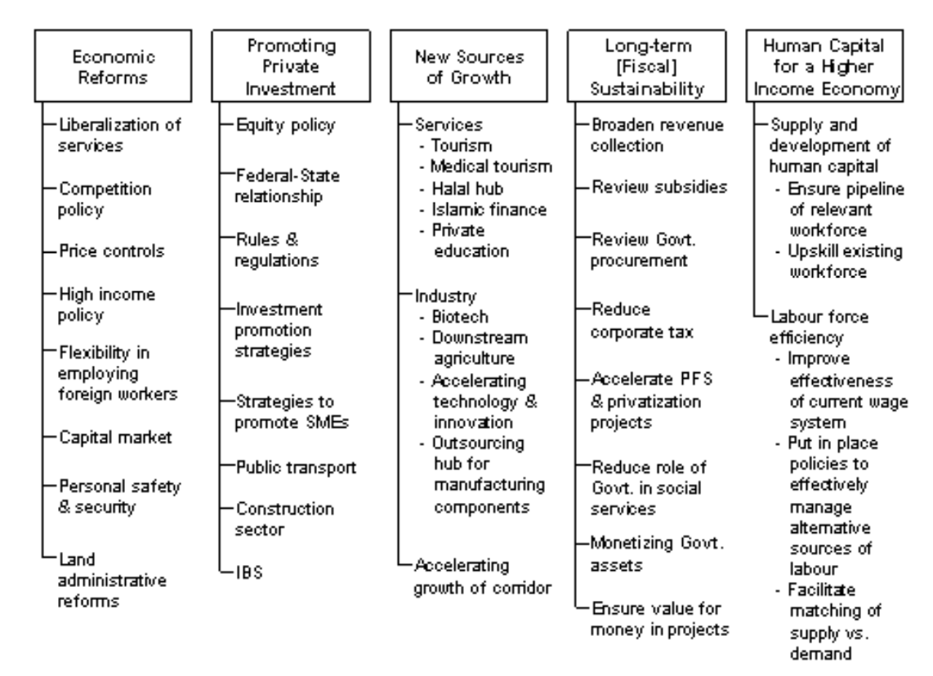
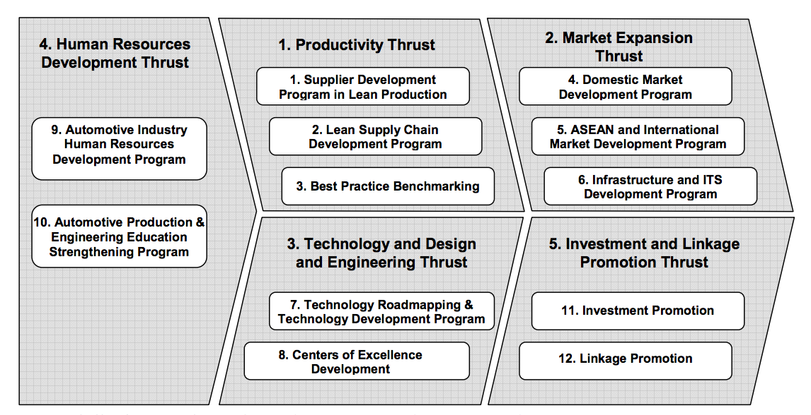
Learning from Malaysia and Thailand’s Experience
Thailand’s Model More Adaptive to Vietnam

Slide 8
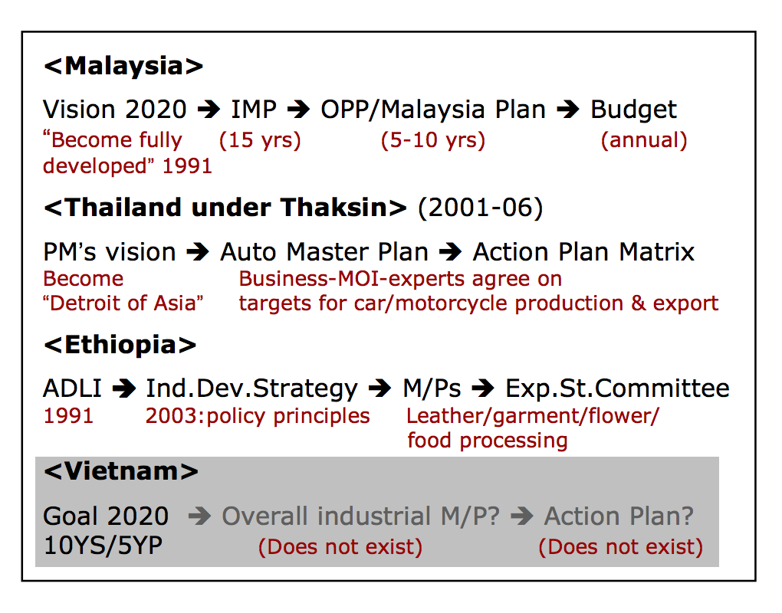
Policy Structure
High performing East Asian economies pursue a goal targeting industrial policy
Vision
Strategies
Action Plans
Vietnam has a vision (Industrialization & Modernization 2020) but it is not backed by concrete strategies and action plans. The roadmap is unclear.

Slide 9
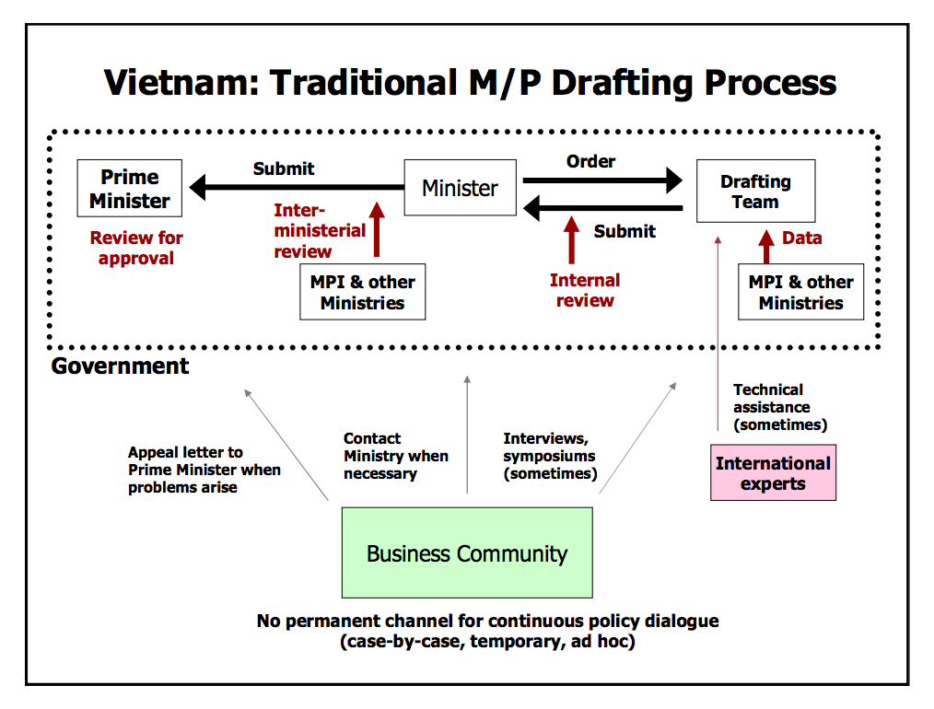
Vietnam’s Policy Making Challenges
Procedural Problems
Lack of involvement of business community
Lack of inter-ministerial coordination
Organizational Problems
Lack of clear directives from the top
Distorted incentive mechanism among government officials that causes brain drain

Slide 10
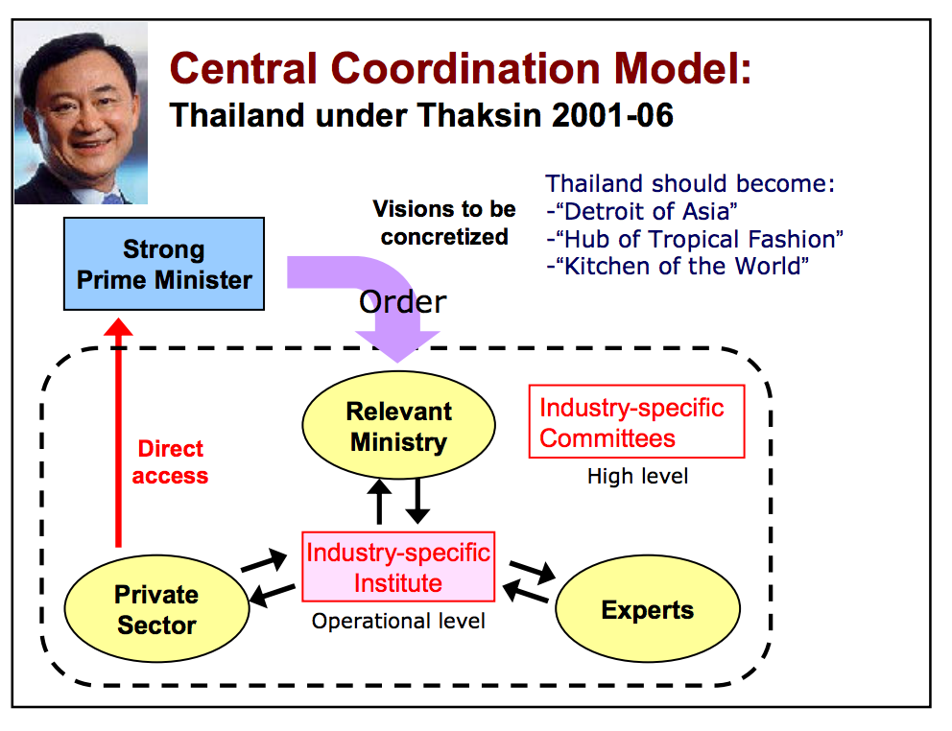
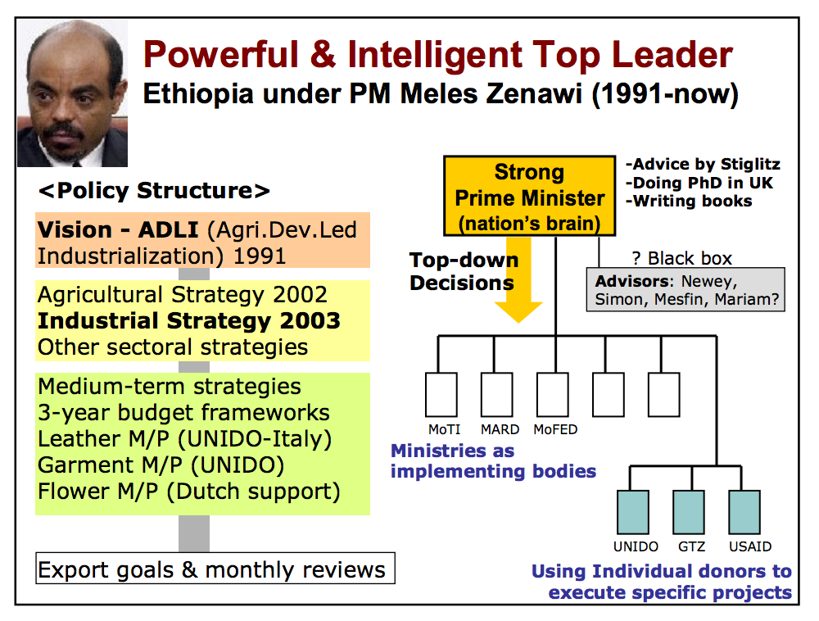
Thailand and Ethiopia Policy Process

Slide 11
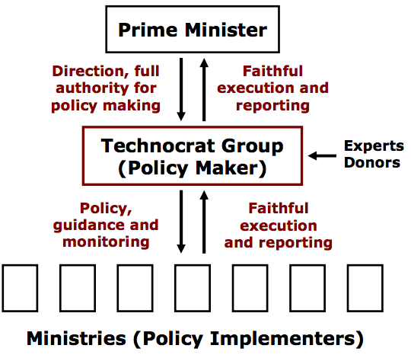
Proposal: Policy Formulation for Vietnam
Elite technocrat group under strong leadership of Prime Minister
Choose young, well educated officials and experts
Simplify policy authority and procedure
Expected Results
Strong top-down visions from PM; sufficient authority for technocrats to execute orders
Action-oriented policy making with speed and flexibility
Removal of bureaucratic formalism & inaction, nepotism, corruption, secrecy
Public sector renovation – compact size, competitive recruitment, attractive salary, performance-based promotion, pride to serve the country

Slide 12
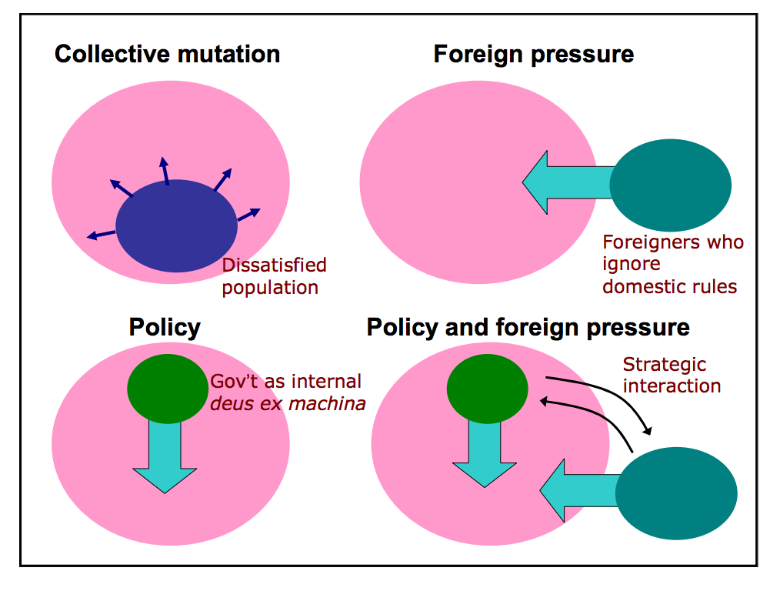
Breaking a Solidified System
According to Comparative Institutional Analysis (CIA), a once established system resists change because of:
Institutional Complementarity: any social system has resilience to shocks because its social systems enhance each other.
Strategic Complementarity: individuals in such an institutionally solidified society have little incentive to deviate from the dominant behavior.
Path Dependence: once installed by chance or design, any social system requires a large amount of political and social energy to change it.
Making Institutional Reform Possible
Leadership
The Technocrat Team
Foreign Partnership

Slide 13
Conclusion
Comments
Vietnam has reached the point where further progress towards higher income can be secured only if internal value creation is enhanced.
This calls for proper government action to guide and complement private sector dynamism and avoid the middle income trap.
To improve policy quality, Vietnam needs to change the policy formulation process. This requires radical change in public administration system.
Strong leadership, a new technocrat team, and strategic partnership with foreigners have been proposed as effective starting points that satisfy these conditions.
The points argued and recommended are relatively superficial and not backed up with concrete evidence
Breaking a solidified system requires beyond an influential leader, technocrat team functioning under a president, and foreign pressure
The paper rarely discuss about policies and means to internalize skills and technology and develop strong human resource
There is lack of proposals on engaging the business community and other external stakeholders in the structures provided for policy formulation and implementation
Other factors such as political agenda, regional politics, and history of internal stability have been ignored
There is hardly any recommendation on improving institutional systems (technology and etc) for effective policy formulation, implementation and evaluation.

Slide 14
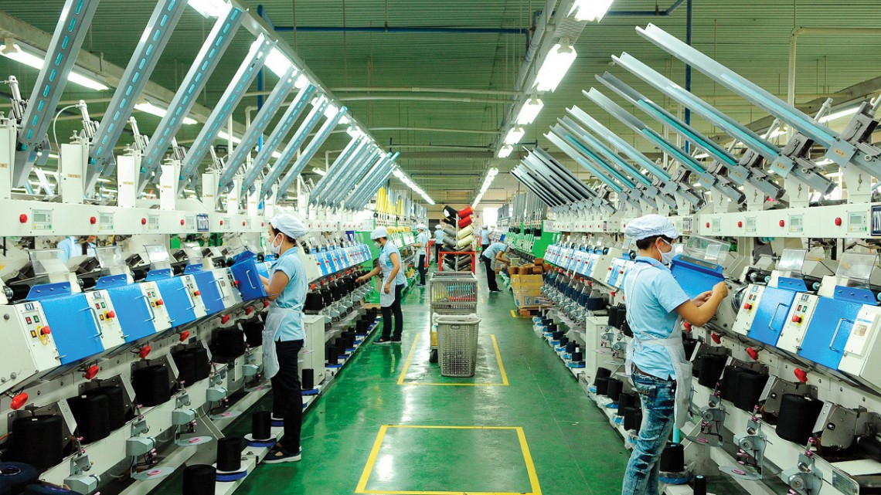
Thank You!

